Slide 1

Sauce Demo Web Application Testing
Software Testing Team: Caleigh Goliath, Awonke Lubelwana, Buhle Palaza, Iviwe Hlatana and Alulutho Tokwe

Slide 2

What is Sauce Demo and Our Aim ?
Sauce is a “dummy” e-commerce website created by Sauce labs, it is used in the software testing industry as a standard sandbox for practicing and demonstrating Manual Testing which means navigating through the site and Automation testing using certain tools.
Aim: Ensure the application meets its functional and non-functional requirements, providing a stable and reliable user experience.

Slide 3

What we Used?
Tools and Languages:
Java, TestNG
Selenium
Environment: Windows 10/11 , IntelliJ Idea Community Edition
Extent Reports(Generates reports automatically based on The Automation Tests)
Browsers: Chrome, Edge and Firefox
Bug Tracking and Reporting: Jira and Word
Test Case Design and Test Coverage Metrics: Excel

Slide 4

Test Plan and Strategy
Testing Approach:
Hybrid Approach: Combined Manual Testing and Automation Testing
Types Of Testing: Smoke, Regression, Exploratory , Functional, Cross-Browser Testing
In-Scope Approach: Authentication, Product Catalog, Cart and Check Out
Out-Scope Approach: Account creation, password reset and Cross browser testing

Slide 5
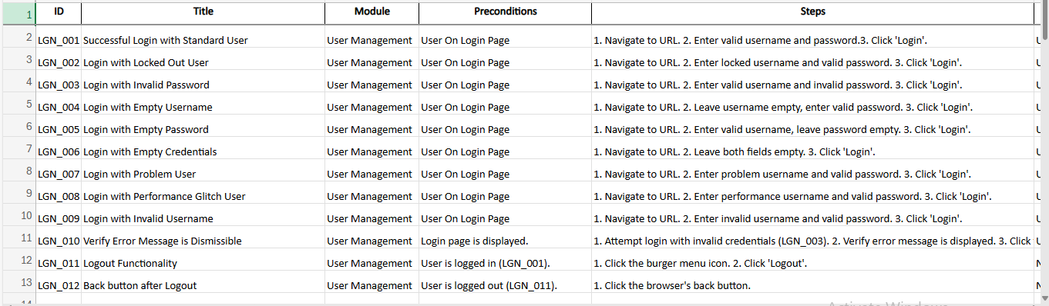
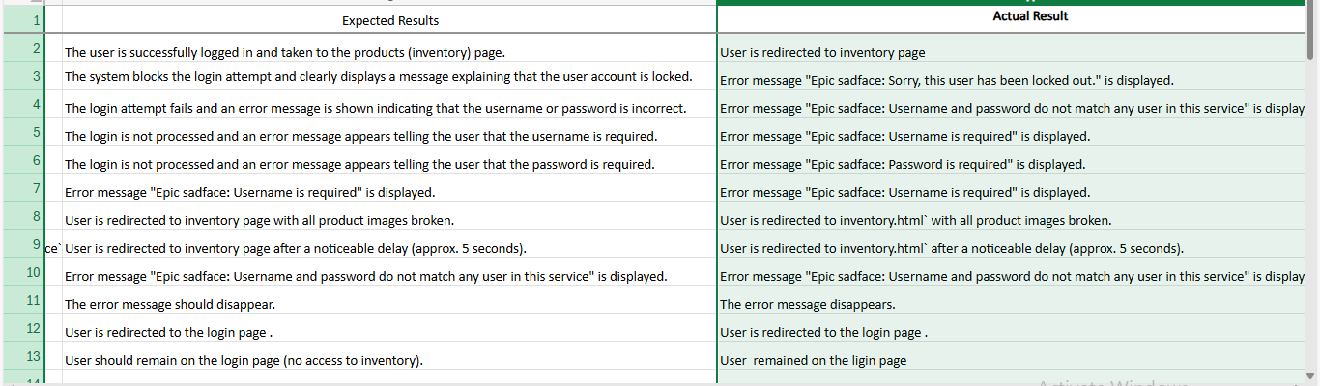
Manual Test Cases:

Slide 6
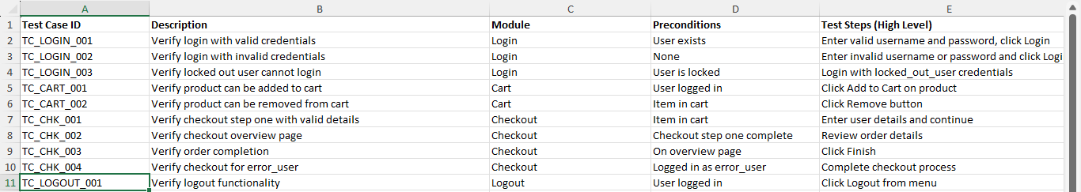
Automation Test Case

Slide 7
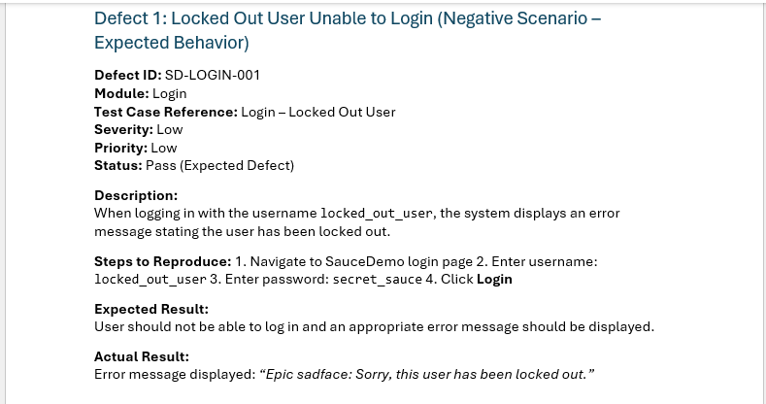
Defect Report:

Slide 8
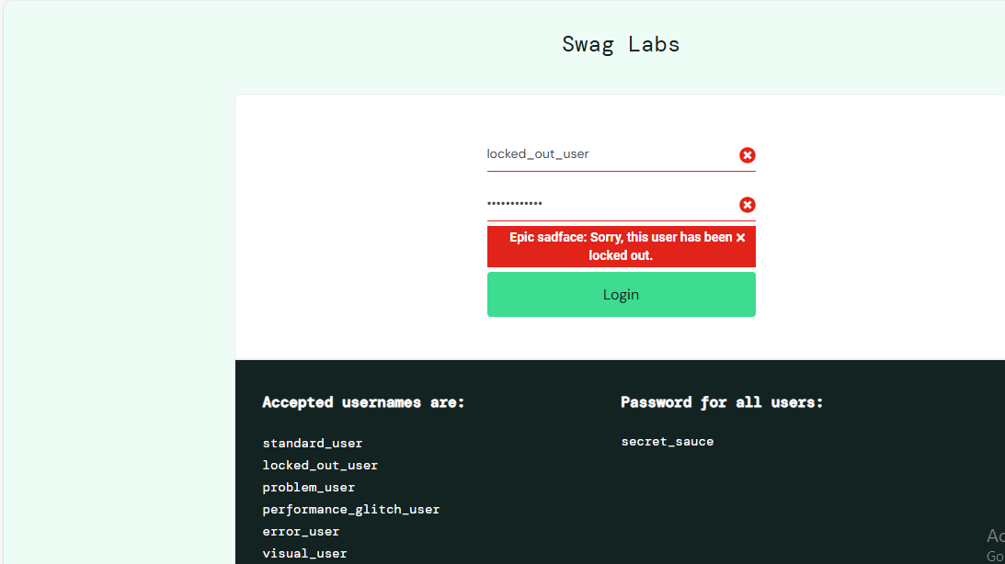
Evidence of the Defect

Slide 9
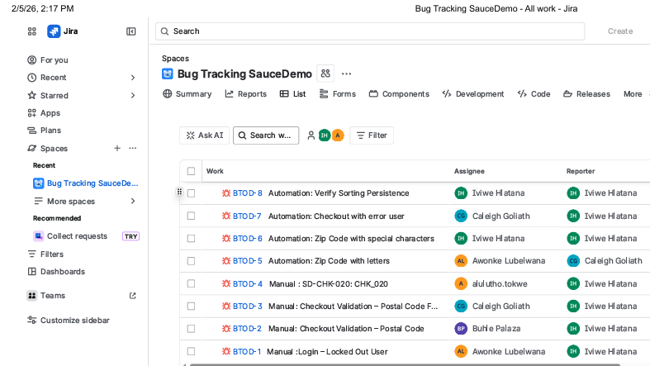
Bug Tracking Using Jira

Slide 10
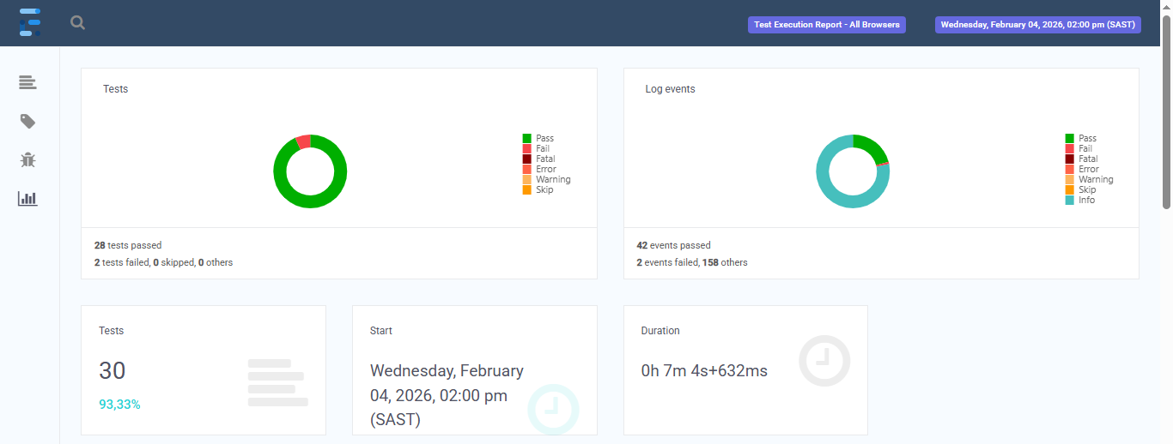
ExtentReports(Html)

Slide 11
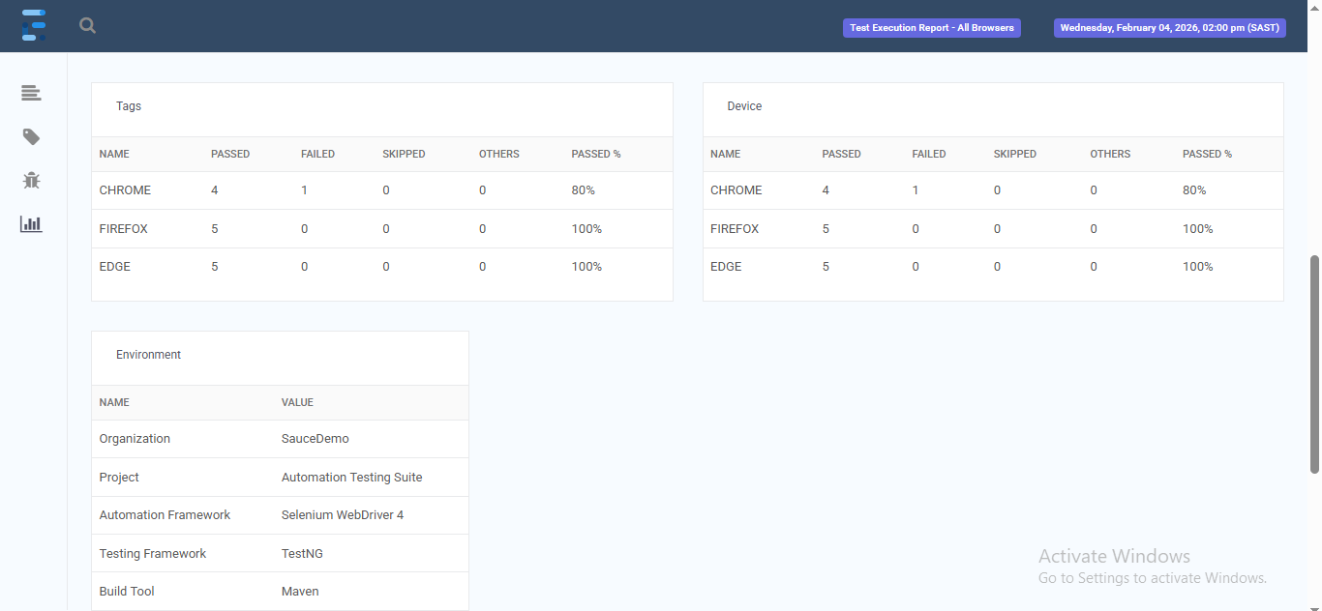
ExtentReports(html)

Slide 12
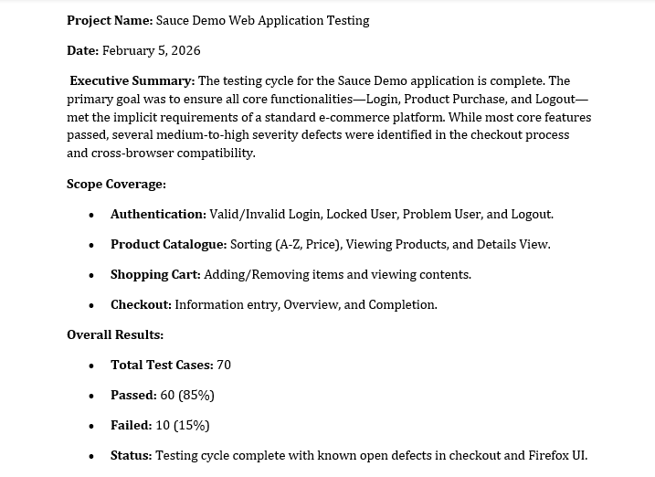
Test Summary Report

Slide 13
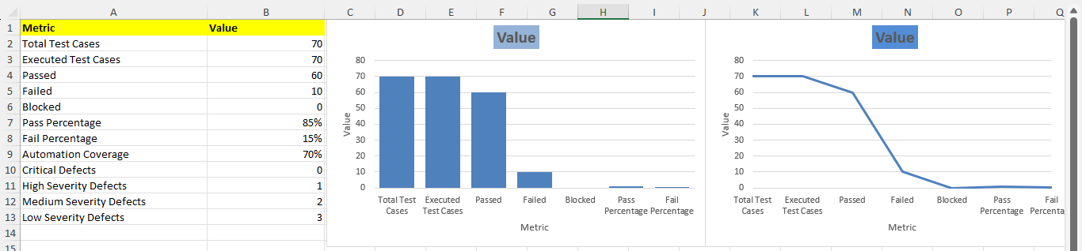
Overall Test Metrics

Slide 14
Lessons Learnt
Automation Suitability: Selenium is reliable for standard UI workflows (e.g., login, checkout), but flows with CAPTCHAs or anti-bot protections must be excluded from automation and tested manually.
Test Stability: Using stable locators and consistent test data significantly enhances the reliability and maintainability of automated test suites.
Clarity in Reporting: Detailed documentation—including clear expected/actual results, screenshots, and evidence—is essential for effective defect analysis and credible reporting.
Strategic Approach: The project highlighted the need to combine manual and automated testing, prioritize high-risk user flows, and acknowledge automation tool limitations to optimize testing efficiency and strategy.

Slide 15

Questions?

